Slide 1
Recovering IP Information in airborne time domain EM Data
Seogi Kang* and Douglas W. Oldenburg
18th Feb. 2015
ASEG-PESA

Slide 2
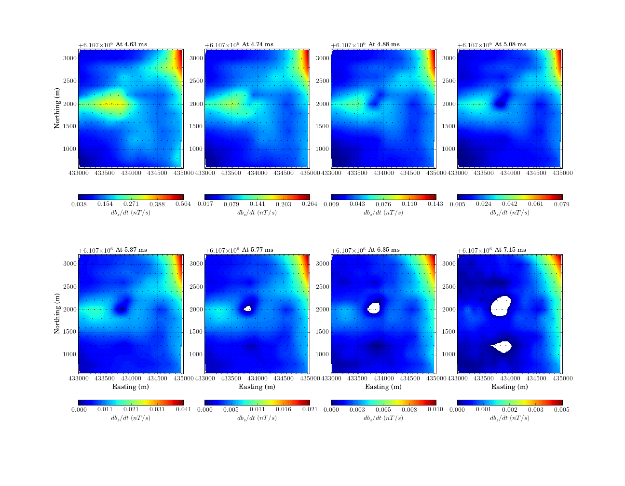
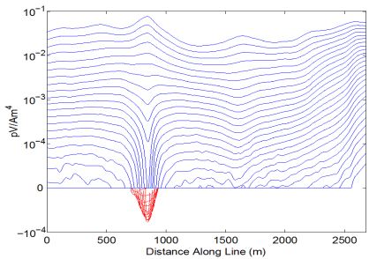
Negative transients in ATEM data
Mt. Milligan
Negative transients of db/dt
Existence of IP body
(Weidelt, 1982)

Slide 3
Objectives
EM decoupling: better identify IP responses
Linearize IP responses
Restore 3D distribution of IP information
Suggest an ATEM-IP inversion procedure

Slide 4
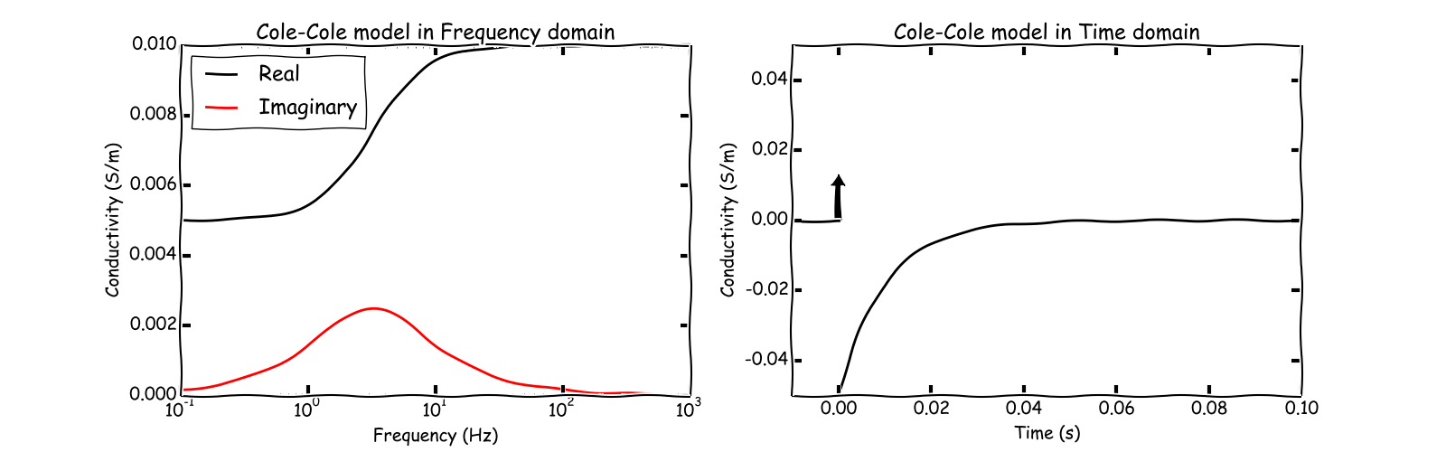
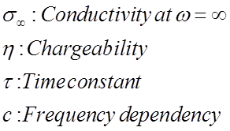
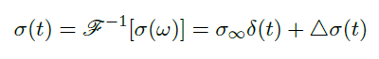
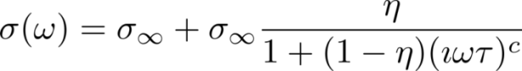
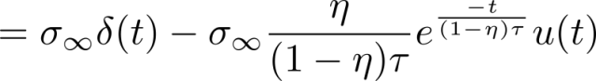
Conductivity is dispersive
Cole-Cole model
In frequency domain
In time domain (assume c=1)

Slide 5
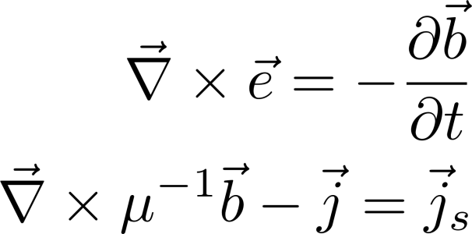
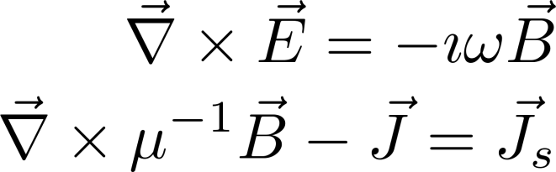
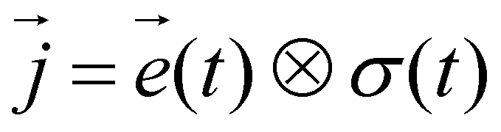
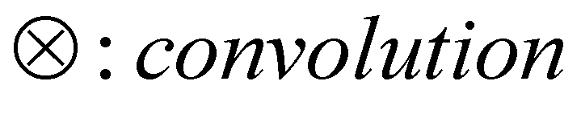
Governing equations
EMTDIP code
(Marchant et al., 2015)
Maxwell’s equations:
Time domain
Frequency domain
Ohm’s law in time domain
Ohm’s law in frequency domain

Slide 6
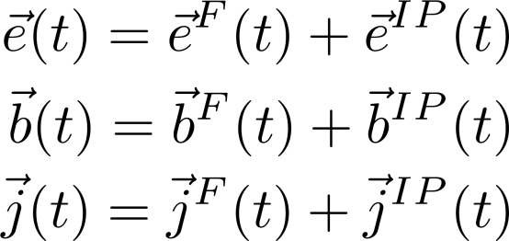
Decomposition of EM responses
EM fields
IP datum
Observation: with IP effect
Fundamental: without IP effect
(Smith et al., 1988)
EM decoupling
IP = Observation - Fundamental
We don’t know

Slide 7
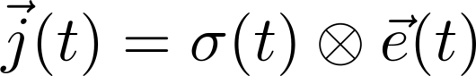
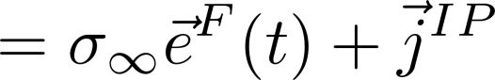
IP current density
Ohm’s law
where

Slide 8
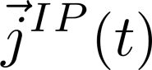
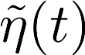
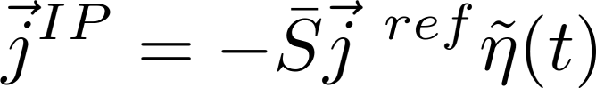
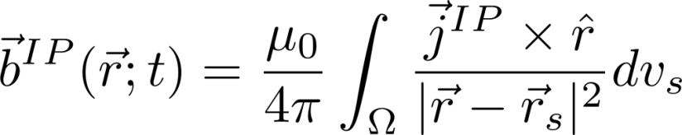
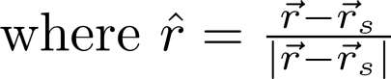
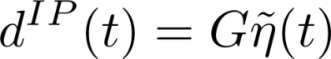
Strategy of linearization
First, approximate as a function of pseudo-chargeability:
Then by applying Biot-Savart’s law (similar to MIP)
We can have linear form:
(Seigel, 1974; Chen et al., 2006)
Notes:
Steady-state DC regime

Slide 9
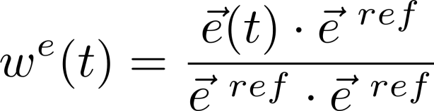
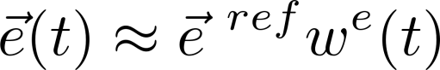
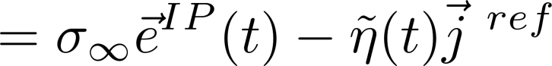
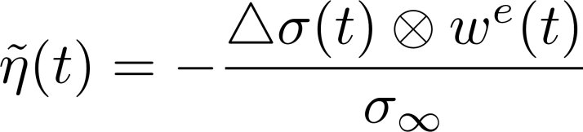
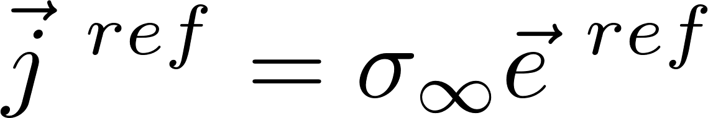
Linearization
IP current density
Approximating
where
Pseudo-chargeability
Reference current density

Slide 10
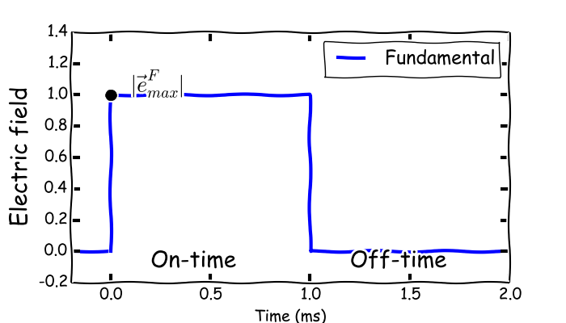
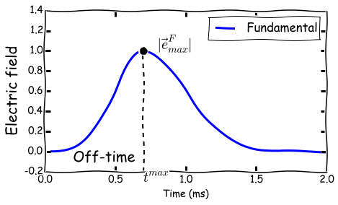

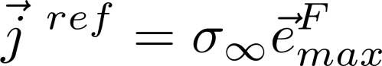
Choice of reference electric field
Which electric field are we going to choose?
DC
EM induction

Slide 11
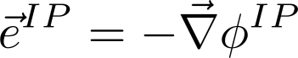
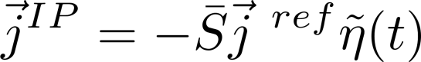
Linearization
IP current density
(Only galvanic)
Rearranging yields
Therefore, we have

Slide 12
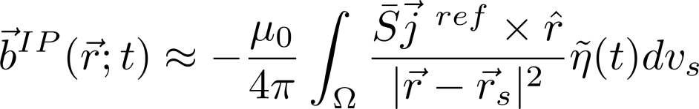
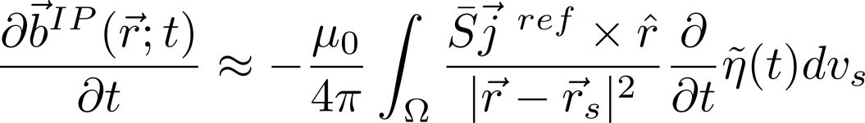
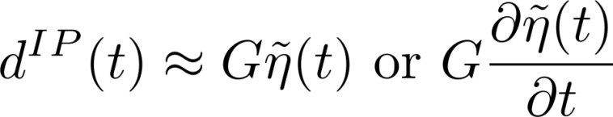
Linear equations
IP responses
Linear equation:

Slide 13
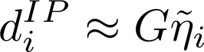
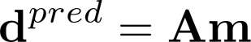
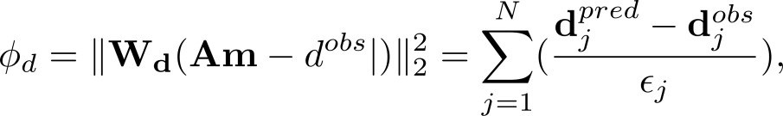
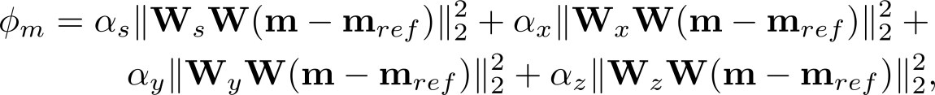
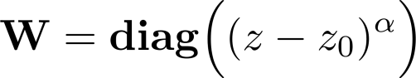
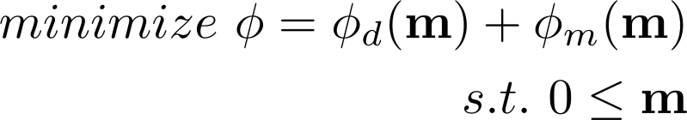
Linear inversion
Linear equation:
Objective function:
Depth weight:
Statement of inversion:
Optimize using projected Gauss Newton

Slide 14
IP inversion procedure
Attempt to avoid soundings/times that have IP coupling effects
Easy if there are negative transients
Invert TEM to recover a background σ model: σ_{est}
Compute d^{IP} data at multiple time channels
Possible estimation of regional field to compensate for approximate conductivity
Selection of negative data
Invert individual
time channels
Pseudo-chargeability: does it give reasonable geometry of IP bodies?

Slide 15
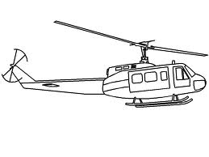
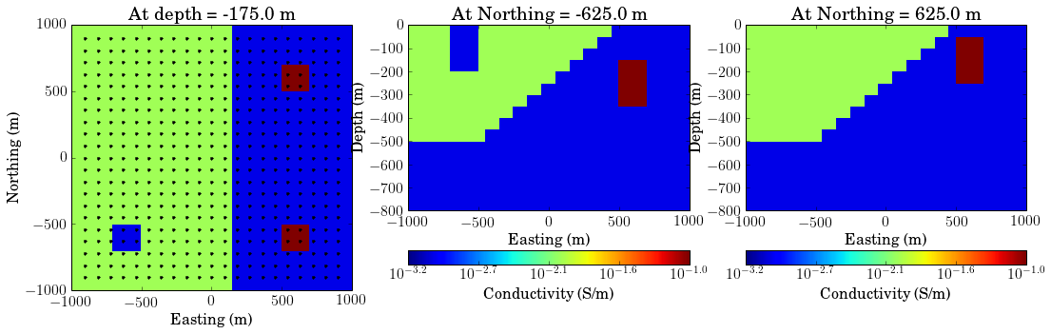
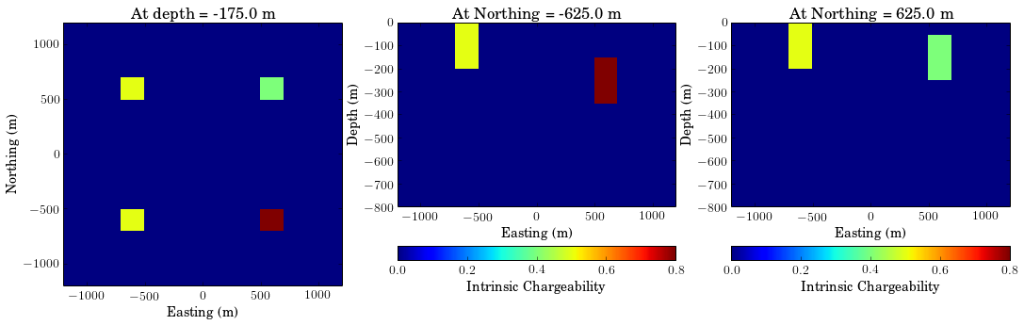
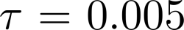
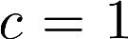
Synthetic Example
Conductivity
Loop source
- 30m above surface
- r=10 m
- Step-off waveform
21×21 = 441 stations
Receivers
- Collocated with Tx
- Measuring db_{z}/dt
- 0.01 – 10 ms
Chargeability ( )
A1
A3
A2
A4
A1
A3
A2
A4

Slide 16
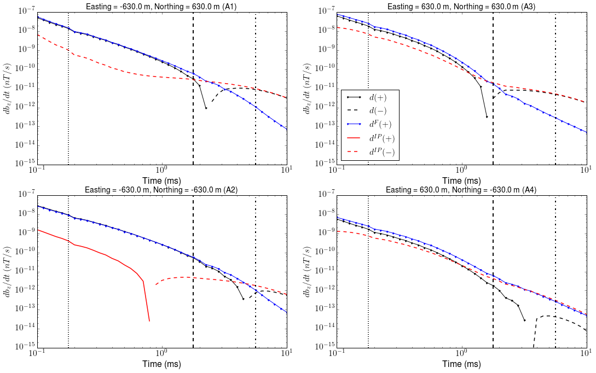
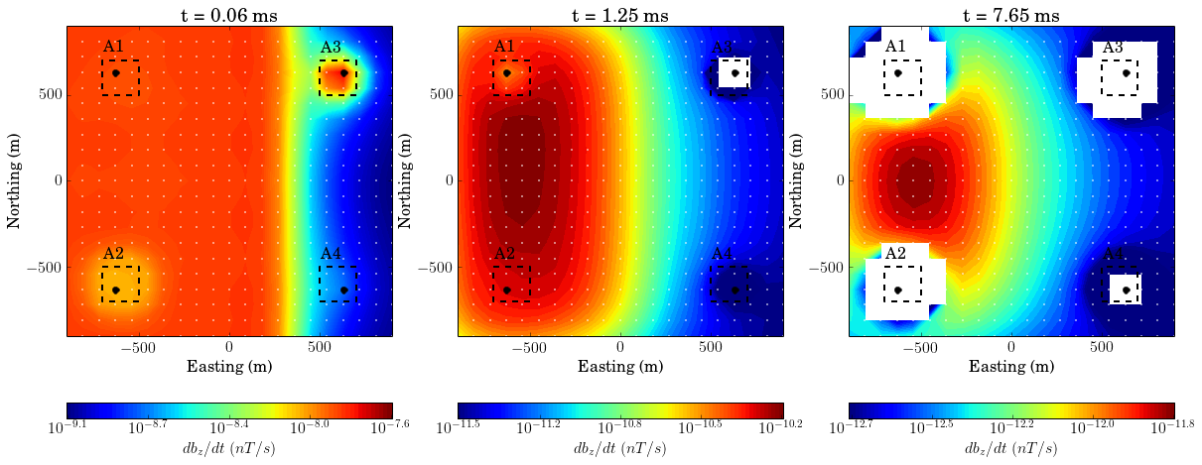
Time decays for four stations
EM dominant
IP dominant
Intermediate

Slide 17
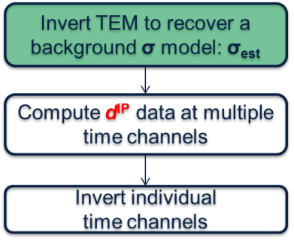
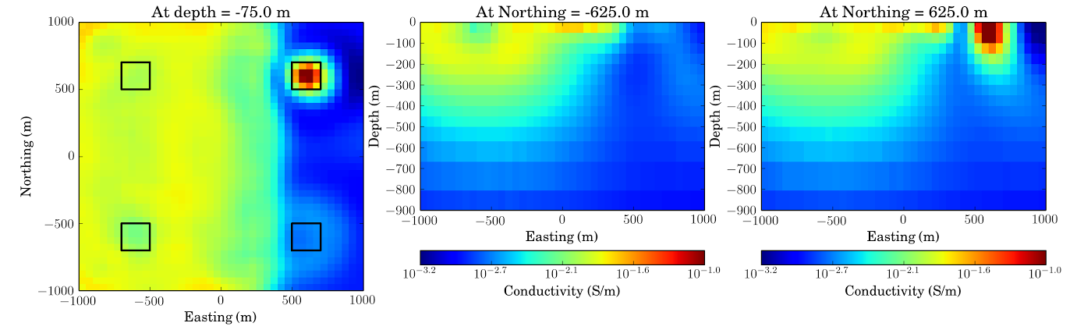
Recovered conductivity model
True conductivity (σ∞)
Estimated conductivity (σ_{est})

Slide 18
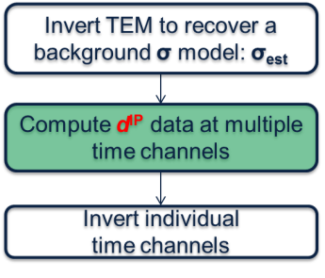
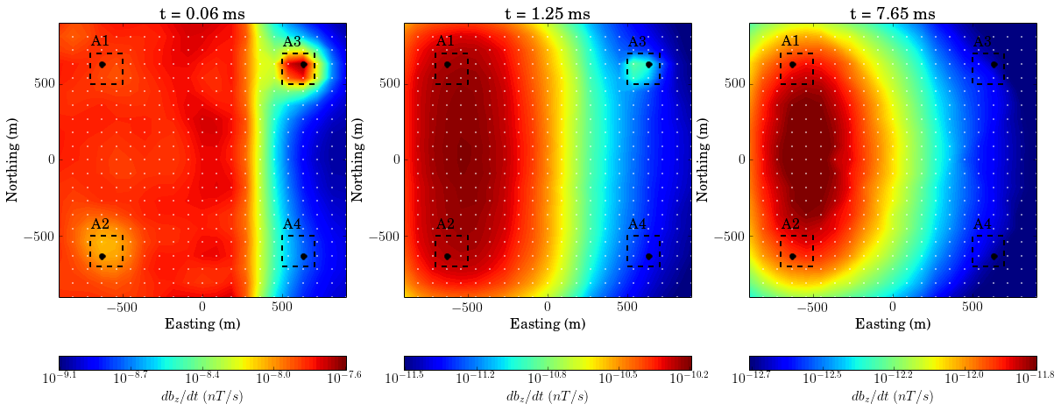
Observation vs. Predicted
EM dominant
Intermediate
IP dominant
Observation
( d[σ(t)] )
Predicted
( d[σ_{est})] )

Slide 19


Transients at four stations
Invert TEM to recover a background σ model: σ_{est}
Compute d^{IP} data at multiple time channels
EM dominant
IP dominant
Intermediate
Invert individual
time channels

Slide 20



Intermediate and IP dominant time
d
d[σ_{est}]
Raw d^{IP}
d^{IP}
t=1.25 ms
t=7.65 ms

Slide 21





3D IP inversion (7.65 ms)
Invert TEM to recover a background σ model: σ_{est}
Compute d^{IP} data at multiple time channels
Pseudo-chargeability
Invert individual
time channels
A1
A3
A1
A2
A4
A3
Pseudo-chargeability provide proper 3D geometry of IP bodies0
A2
A4
Notes:
1.46 2.88
1.46 8.99

Slide 22


Field Example: Mt. Milligan
Observ\ed data (db/dt)
Recovered 3D conductivity model
Yang et al., 2014
Geotech (2007)

Slide 23
IP inversion procedure
Invert TEM to recover a background σ model: σ_{est}
Attempt to avoid soundings/times that have IP coupling effects
Easy if there are negative transients
Invert TEM to recover a background σ model: σ_{est}
Compute d^{IP} data at multiple time channels
Compute d^{IP} data at multiple time channels
Regional removal
Assume IP data are composed of a smoothly varying regional plus true IP data
??
Estimate a regional field
Invert individual
time channels
Subtract regional to obtain
IP data
Not easy; but this issue is confronted before
Invert individual
time channels

Slide 24


Field Example: Mt. Milligan
Obs.
Pred.
Raw d^{IP}
Notes:
0.9 1.81

Slide 25


Choose time at 7.15 ms
Invert TEM to recover a background σ model: σ_{est}
Compute d^{IP} data at multiple time channels
Regional removal
Invert individual
time channels

Slide 26


Regional removal
Invert TEM to recover a background σ model: σ_{est}
Compute d^{IP} data at multiple time channels
Regional removal
Invert individual
time channels

Slide 27





3D IP inversion:
Invert TEM to recover a background σ model: σ_{est}
Pseudo-chargeability model at 7.15 ms
Compute d^{IP} data at multiple time channels
Regional removal
Obseved
Predicted
Invert individual
time channels
A3
A2
A3
A5
A4

Slide 28


Synthetic test
σ∞ model
η model

Slide 29


Compare responses
Field data
(t=4.88 ms)
Synthetic data
(t=0.63 ms)
Notes:
5.7 2.08
5. 8.34

Slide 30

Compare responses
Field data
(t=7.15 ms)
Synthetic data
(t=1.3 ms)
Notes:
5.7 2.08
5. 8.34

Slide 31




Recovered pseudo-chargeability
Synthetic at 1.3 ms
Field at 7.15 ms
Notes:
Add 3D figures

Slide 32



Conclusions and discussions
Invert TEM to recover a background σ model: σ_{est}
Linearize time domain IP responses (inductive)
EM decoupling
Compute d^{IP} data at multiple time channels
Regional removal
Crucial to recover background σ
Promising on IP dominant range
Processing might be needed:
- Regional removal
Invert individual
time channels
Notes:
Add some details

Slide 33





Conclusions and discussions
Invert TEM to recover a background σ model: σ_{est}
Pseudo-chargeability:
Provides reasonable geometries of IP bodies
Depth resolution is an issue
Mt Milligan example:
Extract IP information and
Invert
Test Mt. Milligan synthetic
Compute d^{IP} data at multiple time channels
Regional removal
Invert individual
time channels
Notes:
Add some details

Slide 34
Future work
More field data sets and comparison of ground and airborne IP
Artifacts produced by incorrect estimate of σ_{est}
Further work on processing raw d^{IP} data
Potential for analyzing pseudo-chargeability decays to extract spectral information

Slide 35






Field Example: Tli Kwi Cho Kimberlite

Slide 36
Thank you☺

Slide 37
Acknowledgement
We thank Dikun Yang for 3D ATEM inversion of Mt. Millgan data and David Marchant for providing EMTDIP code. Thanks also developers for GIFtools and SimPEG.

Slide 38




Field Example: Tli Kwi Cho Kimberlite

Slide 39



Field Example: Tli Kwi Cho Kimberlite

Slide 40

Regional removal
Notes:
Add equations:

Slide 41


3D IP inversion (1.25 ms)
Without regional removal
With regional removal
Notes:
1.46 2.88
1.52 8.99

Slide 42

3D IP inversion (7.65 ms)
Without regional removal
With regional removal
Notes:
1.46 2.88
1.46 8.99

Slide 43








Pseudo-chargeability
Assume Cole-Cole model with c = 1
Letting yields
We first recover or
Then recover intrinsic IP parameters

Slide 44







Estimate intrinsic IP parameters
Division | True b | Estimated b
A1 (=0.5, =0.005) | 400 | 255
A2 (=0.5, =0.005) | 400 | 256
A3 (=0.4, =0.005) | 333 | 241
A4 (=0.8, =0.005) | 1000 | 418

Slide 45
Acknowledgement

Slide 46


Negative transients in ATEM data
Tli Kwi Cho kimberlite complex: VTEM data
We can “measure” negative transients in the field data
1D approach computing apparent chargeability (Kratzer et al., 2012)

Slide 47
IP inversion procedure
Attempt to avoid soundings/times that have IP coupling effects
Easy if there are negative transients
Invert TEM to recover a background σ model: σ_{est}
Compute d^{IP} data at multiple time channels
Assume IP data are composed of a smoothly varying regional plus true IP data
Estimate a regional field
Subtract regional to obtain
IP data
Not easy; but this issue is confronted before
Invert individual
time channels

Slide 48



Slide 49
Total responses
EM dominant
Intermediate
IP dominant
Notes:
1.02 4.33

Slide 50
Raw d^{IP} responses
EM dominant
Intermediate
IP dominant

Slide 51




Conductivity with geology
A
B
C
Notes:
Need to know more about geology

Slide 52




Pseudo-chargeability with geology

Slide 53

A3
A2
A4
A3
A5

Slide 54
A3
A2
A4
A3
A5

Slide 55

A3
A2
A4
A3
A5

Slide 56
A3
A2
A4
A3
A5
Notes:
meshtools3d -43.7998 -28.6001 42 16 26 16 16 10 8 0 0 0 0 0 0 5 0 0 1382 744

